Slide 1

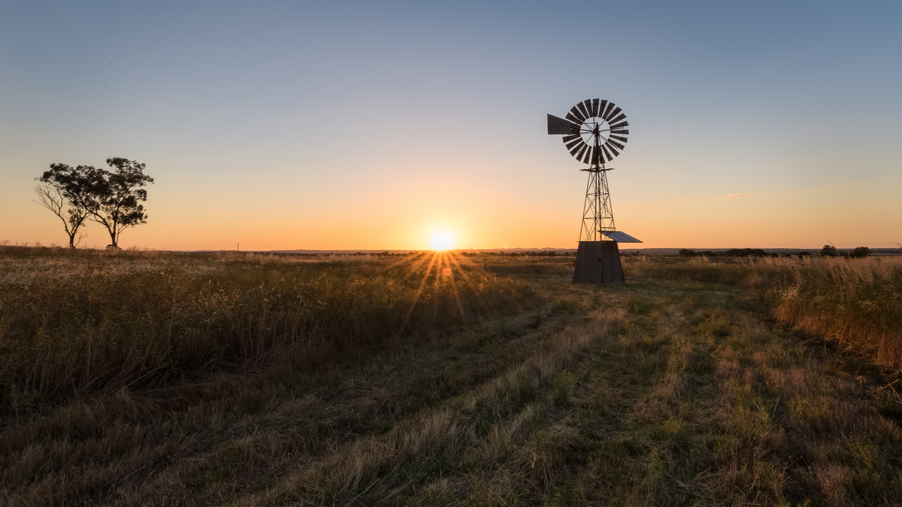
Flood Analysis
Analysing the impact of climate change on Queensland Cattle markets, intermediated by increased flood events

Slide 2


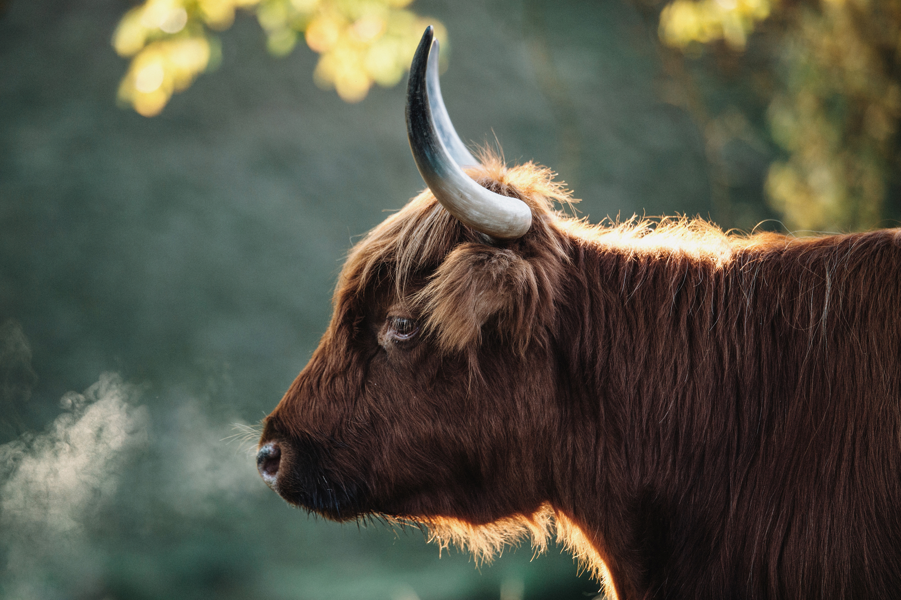

Breakdown of analysis
Taryn Question 1: Understand the shape of flooding and rainfall data over time | Van Question 2: Understand temperature as a driver of flooding | Anna Question 3: Understand the impact of flooding on cattle headcounts and saleyard prices | Tom Question 4: Forecast spatial changes in agricultural productivity in the future

Slide 3


Understand the shape of flooding and rainfall data over time
Hypotheses
- Increase in river discharge means increased flood risk across both cities
- The frequency of rainfall has increased over time
- The frequency of floods has increased over the last 3 decades
**Definitions**
- River discharge is the volume of water flowing through a river channel. This is the total volume of water flowing through a channel at any given point and is measured in cubic metres per second (cumecs). The discharge from a drainage basin depends on precipitation, evapotranspiration and storage factors. Drainage basin discharge = precipitation – evapotranspiration +/- changes in storage.
Data sources
- Open Meteo Flood API (GloFAS), 1990-2020, Queensland
- https://www.internetgeography.net/topics/river-discharge/
**Visualisation**
- River discharge time series
- Rainfall over time series

Slide 4
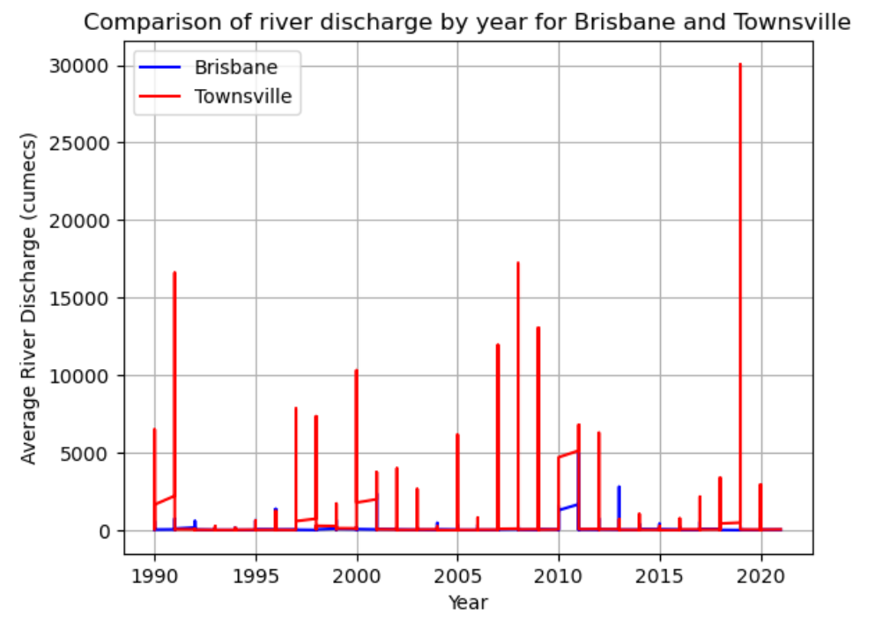
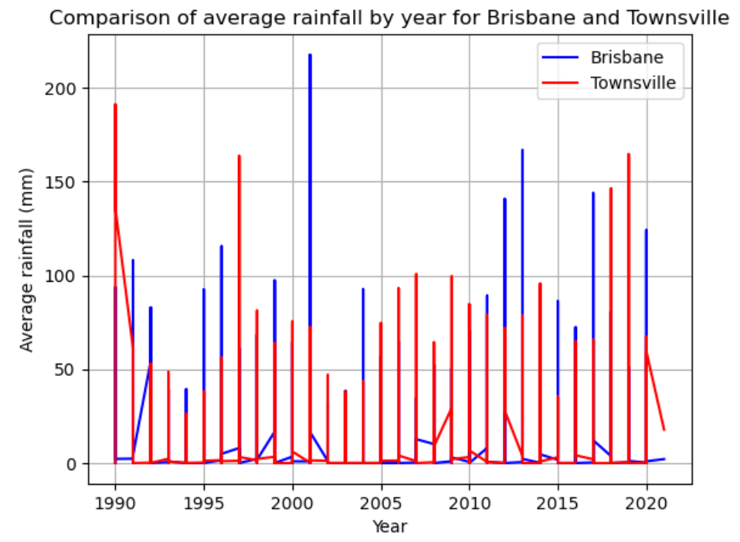
Flood and rainfall data over time
Average river discharge by year
Average rainfall per year

Slide 5
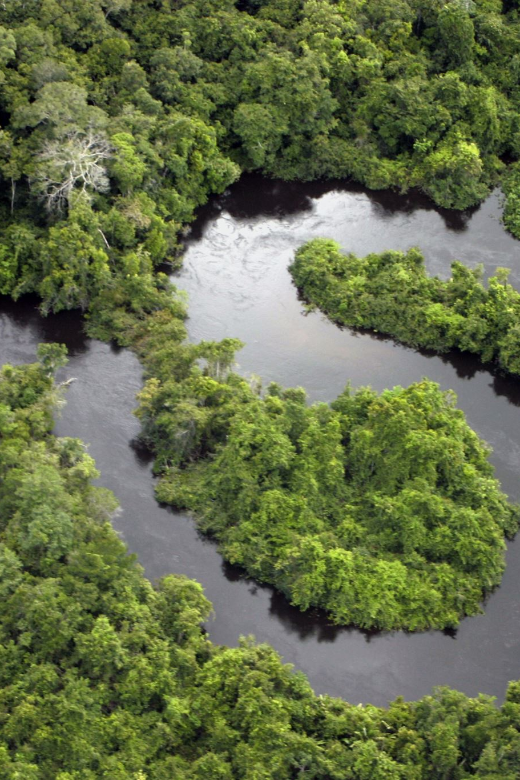
Analysis
The average rainfall for Brisbane is higher than Townsville
The average river discharge which can be the assumed as flood risk is greater in Townsville compared to Brisbane even though the average rainfall is higher in Brisbane
We can conclude a null hypothesis that increased rainfall equals increased river discharge and therefore flood risk for the two cities
River discharge has not increased in severity over time, there is no pattern for higher than average river discharge for either city resulting in a null hypothesis
Rainfall average mm has increased above 75mm in the last 10 years compared to previous years where there were peaks above 150 and dips below 50. Average rainfall has been consistently more severe from 2010 - 2020 compared with 1990 to 2010 where there are 3 sharp peaks and lower average rainfall.

Slide 6
The association between Temperature, Rainfall and Flooding in Queensland
Hypotheses:
Hotter weather leads to more flooding (more severe, more frequent)
Data sources
Open Meteo Flood API (GloFAS) 1990-2020
Open Meteo Weather API
Visualisation
Temperature time series
Flooding time series

Slide 7
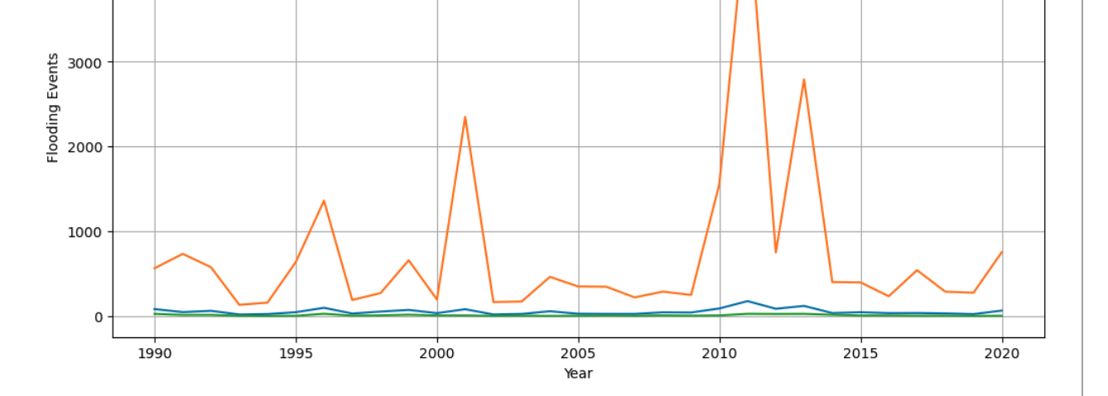
Frequency and intensity of flooding events from 1990 - 2020

Slide 8
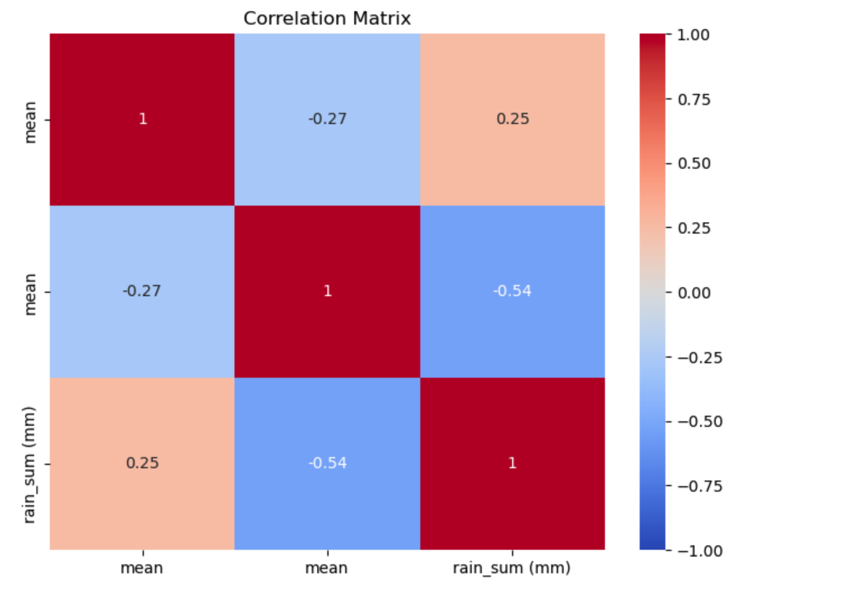
Correlation Matrix Heatmap
Utilized a cool-warm color palette to represent the strength and direction of correlations
Annotated the heatmap with the correlation coefficients
Highlighted the associations between maximum flood values, mean temperature values, and rainfall data

Slide 9
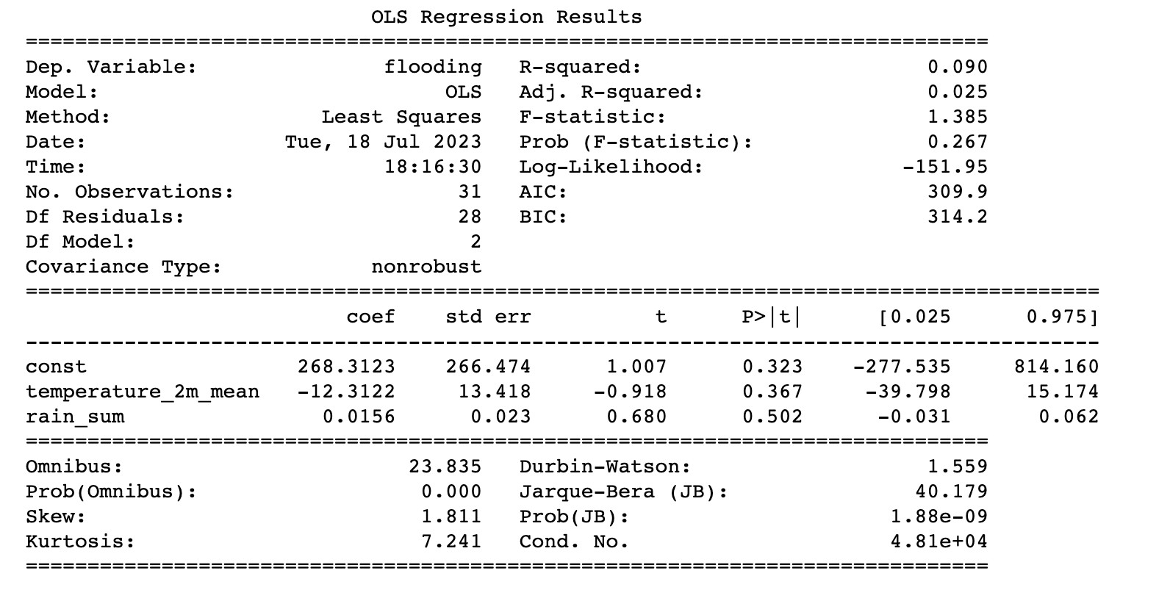
Linear Regression Analysis
Utilized the statsmodels library to perform a linear regression analysis
Created a DataFrame with the variables of interest (flooding, temperature, rainfall)
Fit a linear regression model using the Ordinary Least Squares (OLS) method

Slide 10
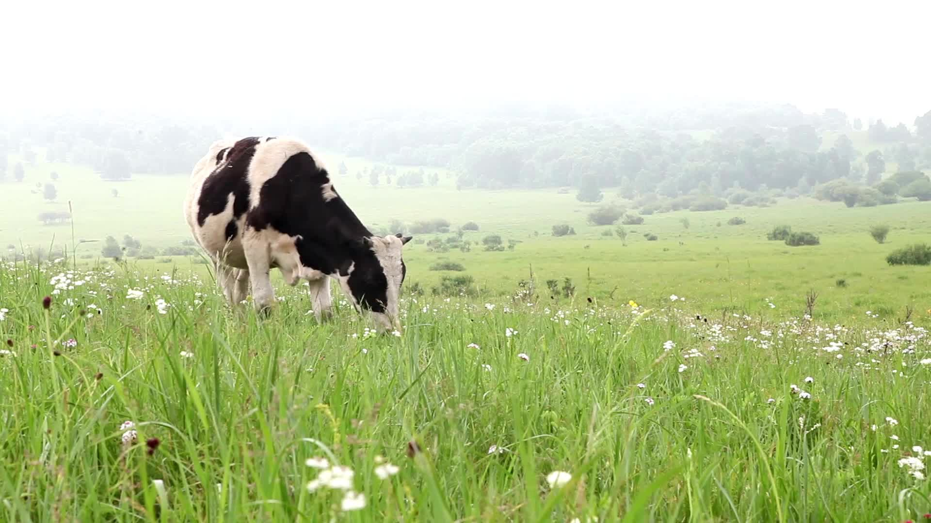
Impact of flooding on cattle headcounts and saleyard prices
Flooding is known to damage and destroy pasture and stock crops, and cause disease among livestock
As well as losing cattle to disease, farmers may need to cull stock to reduce the load on remaining pasture and feed
As Queensland produces over 40% of all Australian cattle, any major impact on cattle numbers in this region is likely to be reflected in overall Australian market cattle prices.
One major indicator of local market prices is the per kg price of yearling cattle at saleyards
Hypotheses:
Cattle numbers will reduce in response to flooding due to lack of feed and disease among livestock
Saleyard prices will increase in response to lower cattle numbers for sale
Data sources
Open Meteo Flood API (GloFAS), yearly 1990-2020, Queensland
Cattle herd size and saleyard prices data was obtained from the Australian Bureau of Statistics

Slide 11
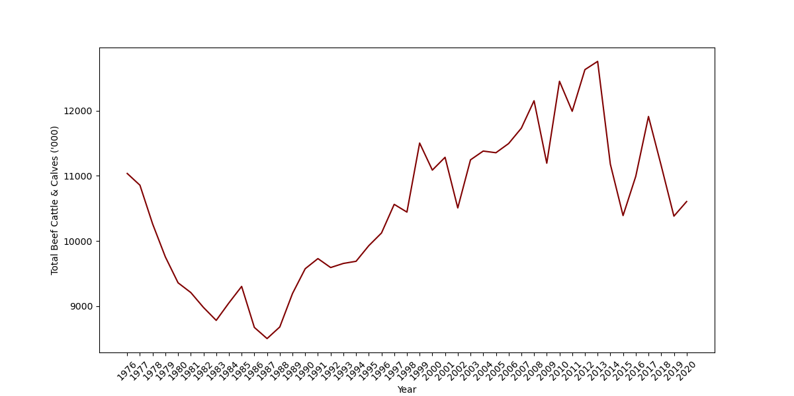
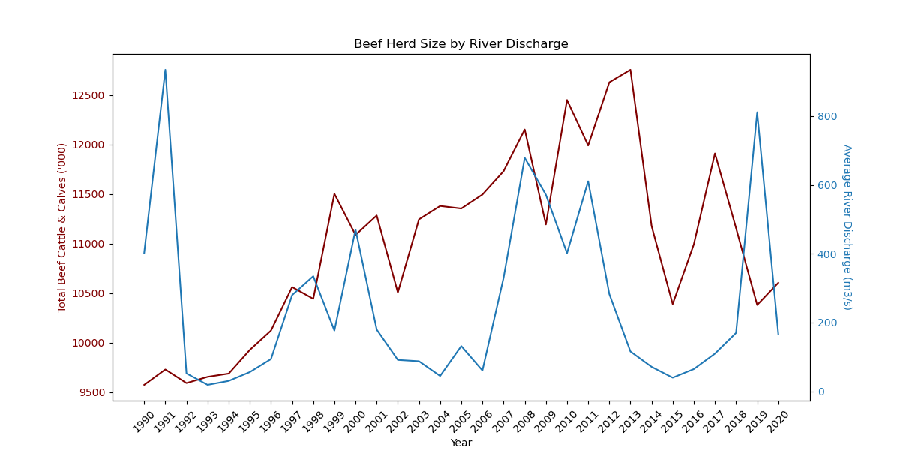
Impact of flooding on cattle headcounts and saleyard prices
Queensland beef herd size 1990-2020
Herd size by flooding

Slide 12
Impact of flooding on cattle headcounts and saleyard prices
Saleyard prices by herd size
Saleyard prices by river discharge

Slide 13
Analysis
Flooding does impact herd size and saleyard prices but ONLY when cattle numbers before the flood are high.
Drought has a more significant impact than flooding.
There may be an “optimum” herd size that is manageable through adverse weather events.

Slide 14
Forecasting spatial changes in agricultural productivity in 2040
Hypotheses:
Some areas will be less productive, some more
Data sources
Open Meteo Flood API (GloFAS) 1990-2020
Open Meteo Weather API
Global warming forecasts
Visualisation
Geospatial heatmap view

Slide 16
Summary Analysis

